Slide 1
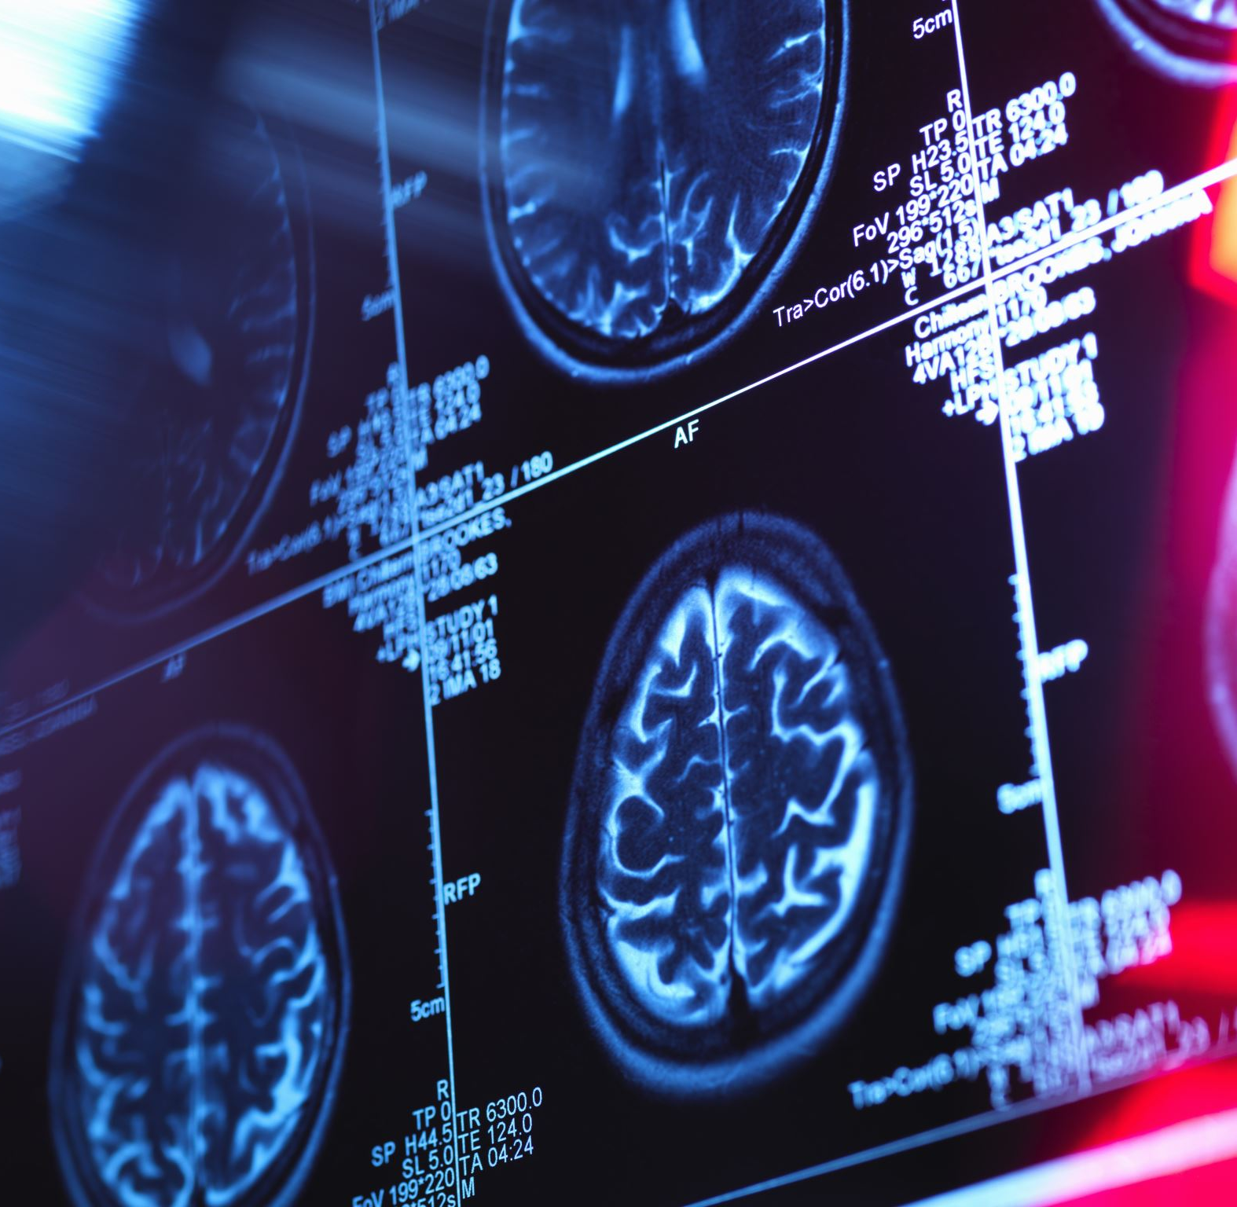
X-Ray Diagnostics Using Machine Learning
By
Lavaneeth Reddy
Siddhartha Thalasila

Slide 2
ABSTRACT
The X-ray diagnostics project aims to develop a computerized system for analyzing X-ray images in order to improve the accuracy and efficiency of medical diagnosis. The system will use algorithms and machine learning techniques to automatically detect abnormalities and anomalies in chest X-ray images, such as pneumonia. The project will involve the collection and analysis of large datasets of chest X-ray images, the development of algorithms analysis, and the creation of the user-friendly interface to interact with the system. The ultimate goal of the project is to improve patient outcomes by providing faster and more accurate diagnoses, ultimately leading to better treatment options and improved quality of life for patients.

Slide 3
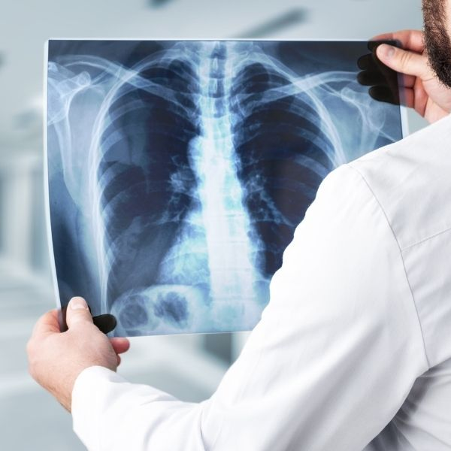
OBJECTIVES
Designing a system for X-ray diagnostics for detecting Pneumonia using chest X-ray images as an input.
Develop an interface which can give instant detection for pneumonia.
Main objective is to achieve better accuracy than existing model.

Slide 4
Outcomes
Instant Pneumonia detection.
User-friendly interface

Slide 5

NOVELTY
Highest accuracy than existing system.
Easy diagnostics
Very User-friendly interface.

Slide 6
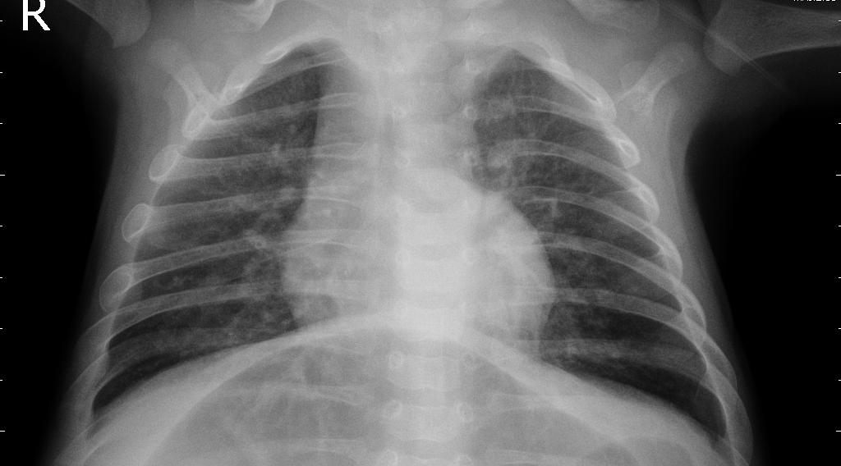
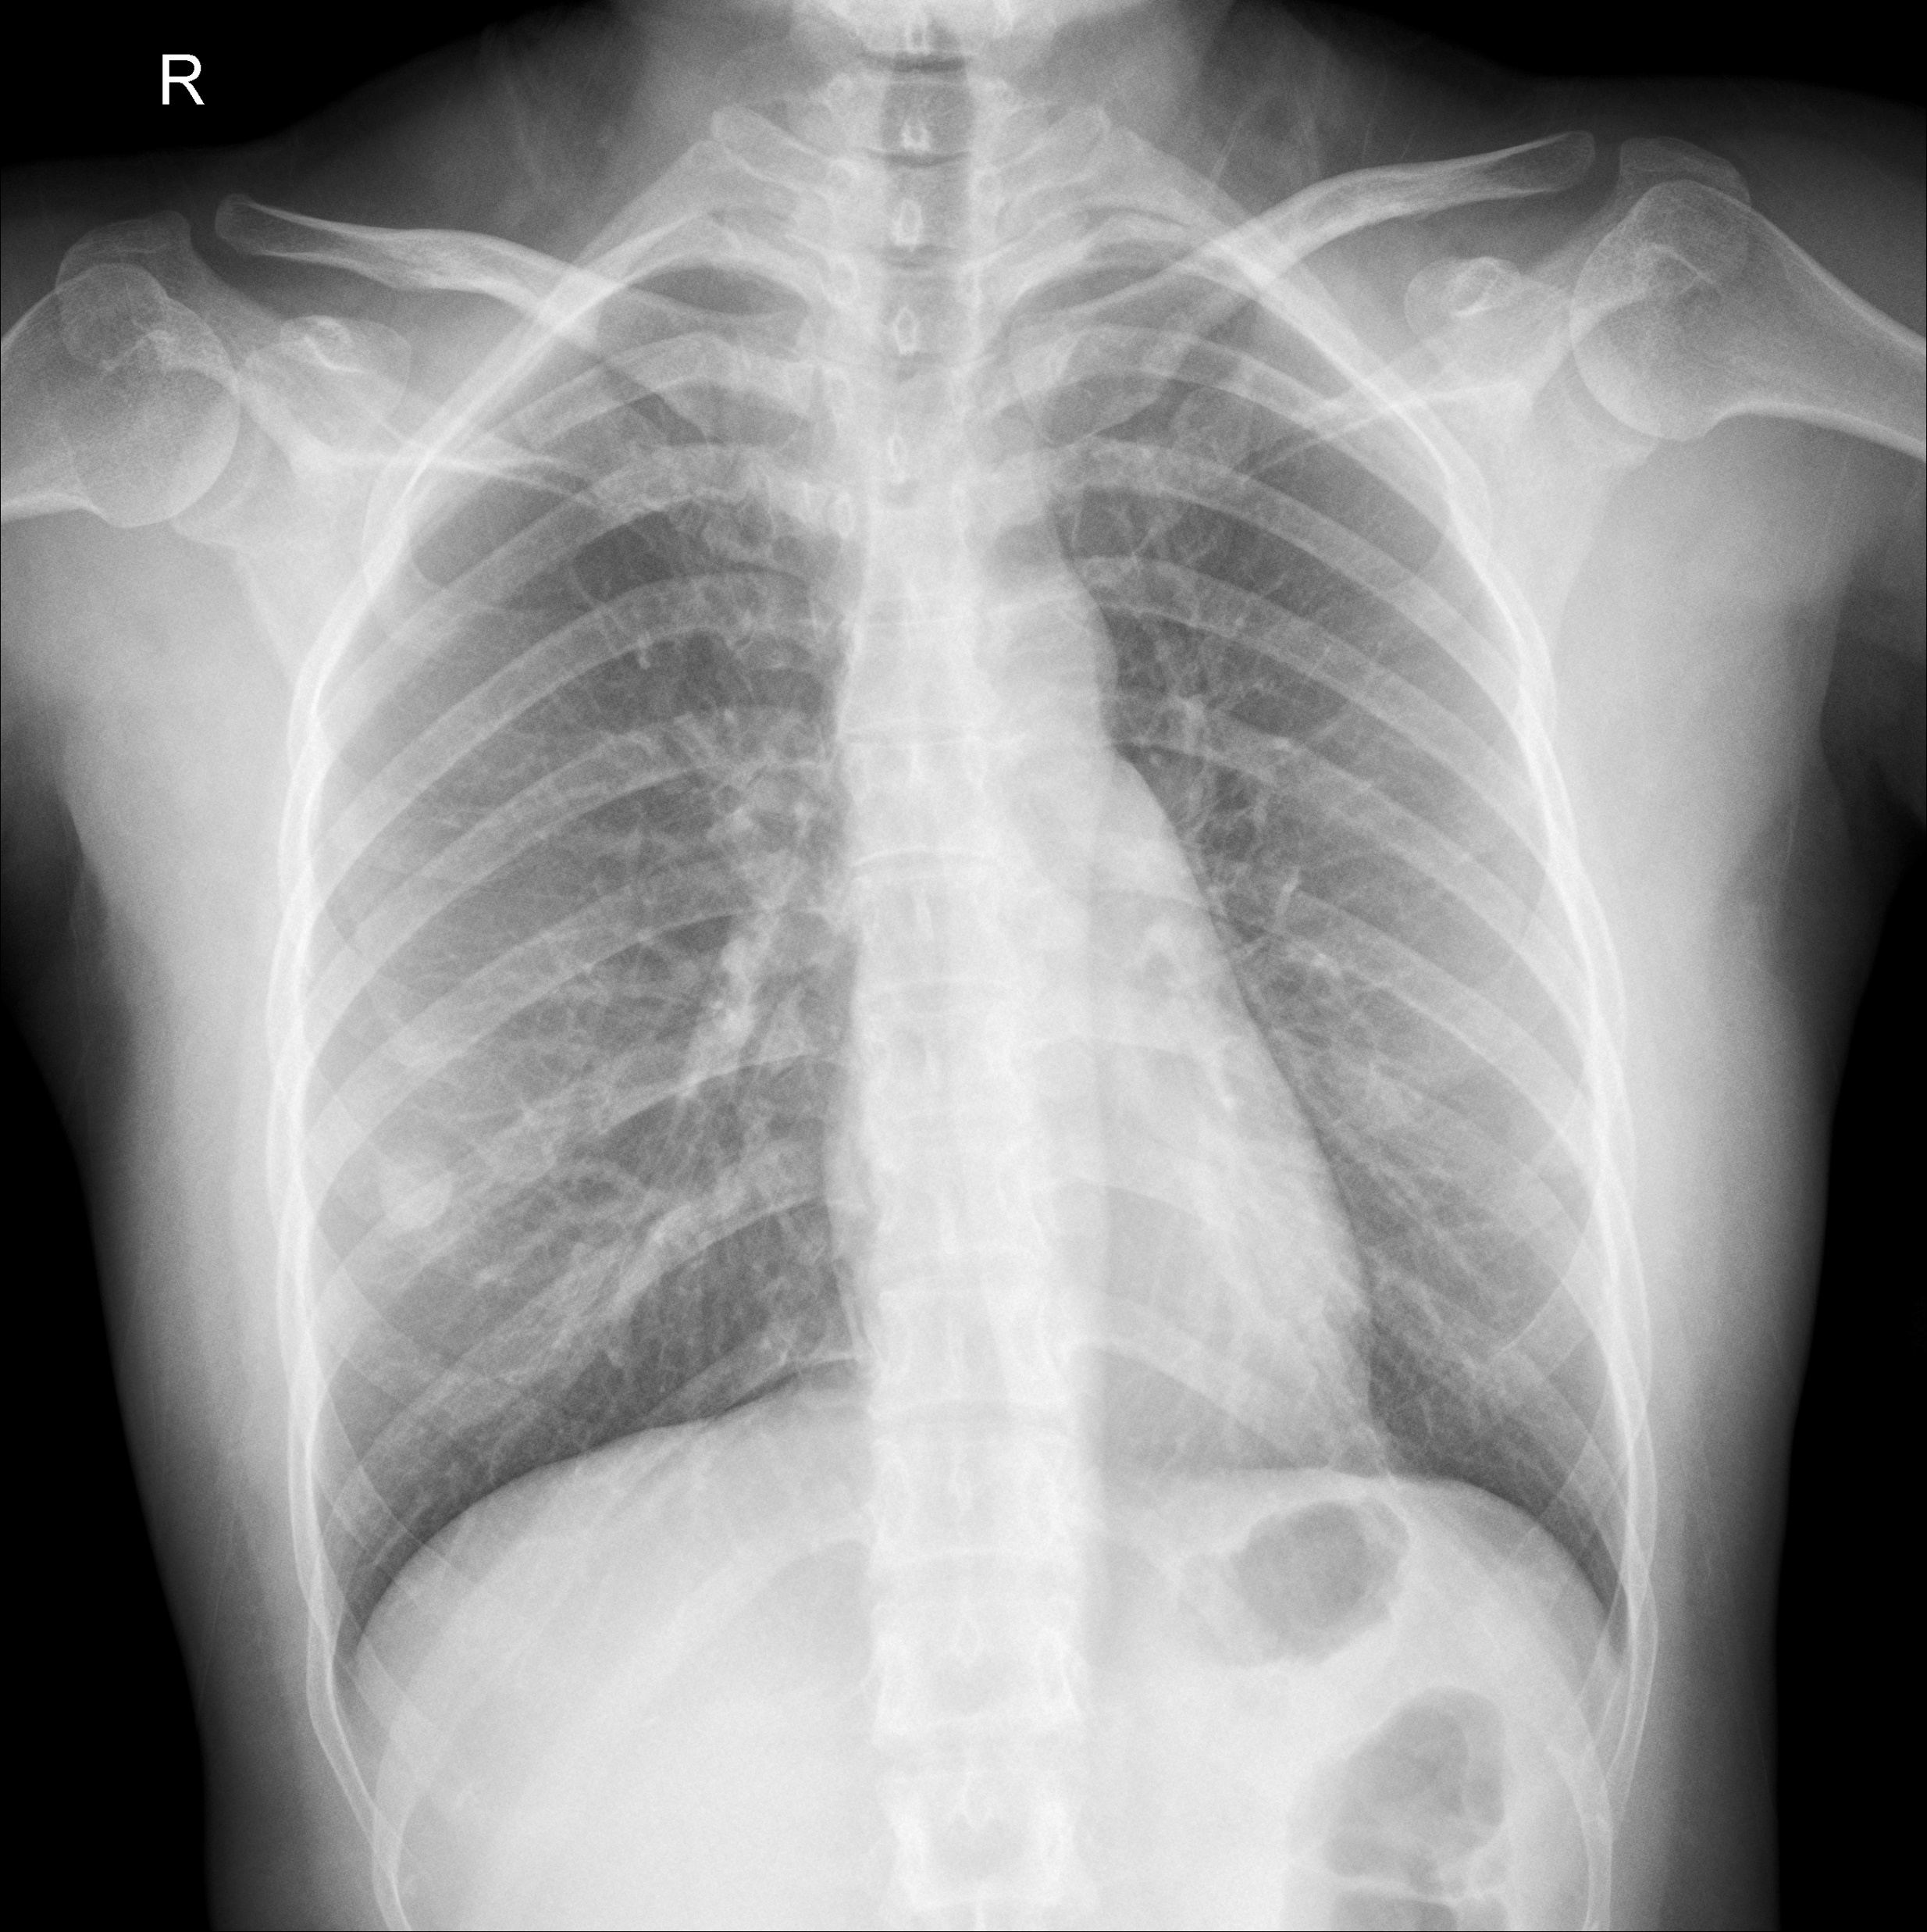
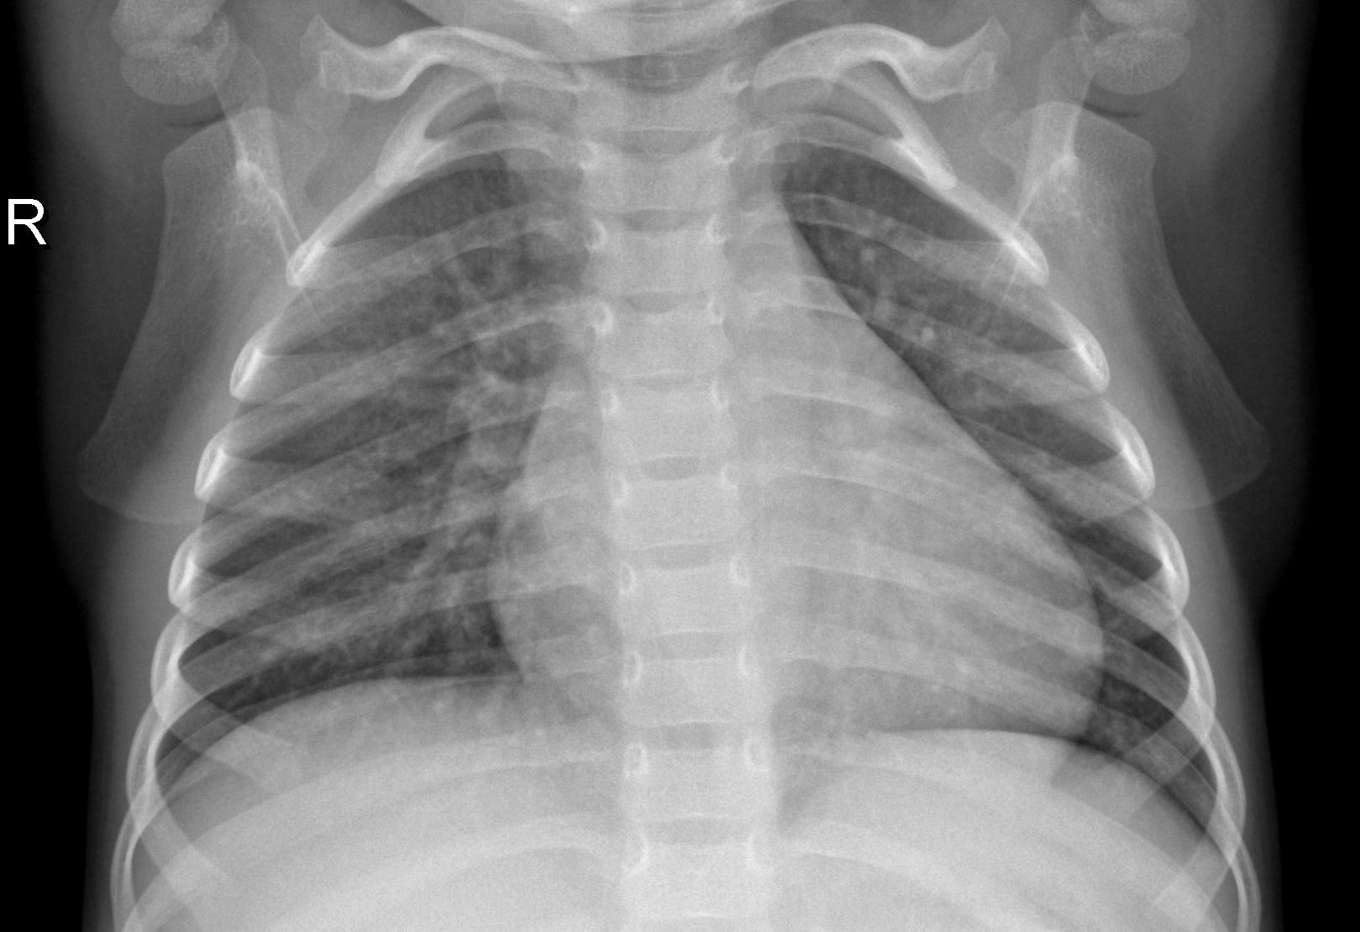
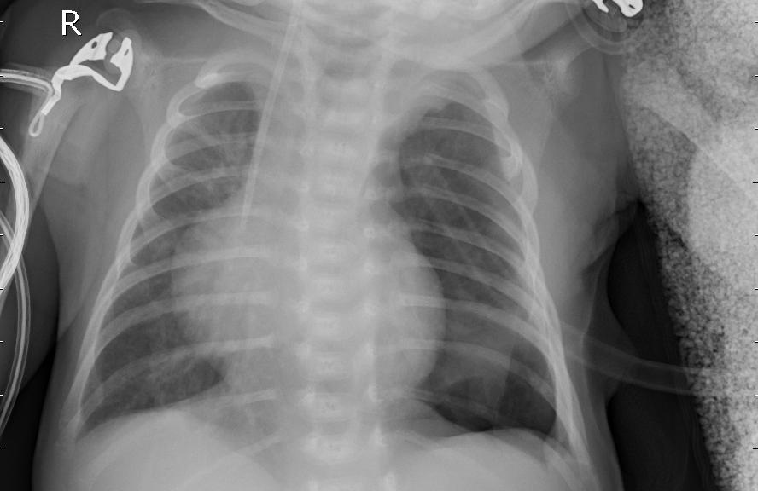
Dataset
Train dataset – 2 classes 5216 images
Test dataset – 2 classes 624 images
Validation dataset – 2 classes 16 images
Source:- https://www.kaggle.com/datasets/paultimothymooney/chest-xray-pneumonia?datasetId=17810

Slide 7
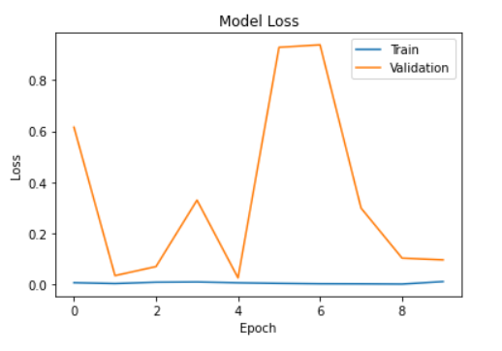
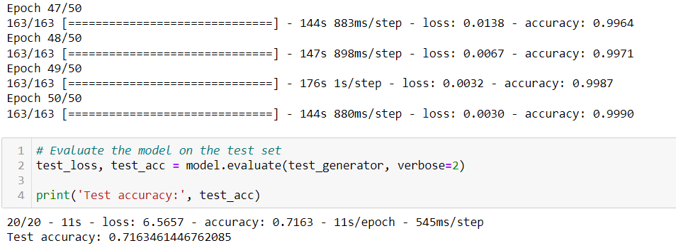
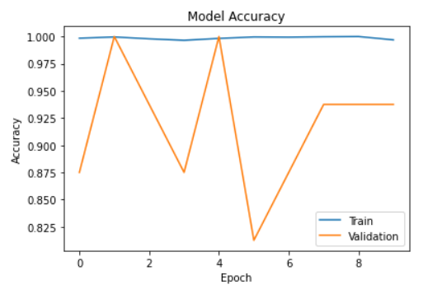
Results

Slide 8
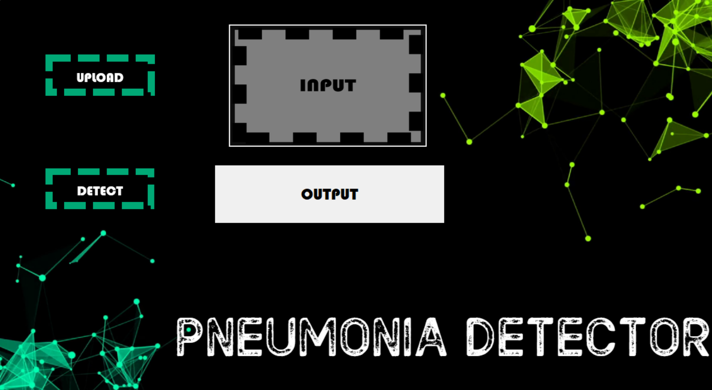
Results

Slide 9
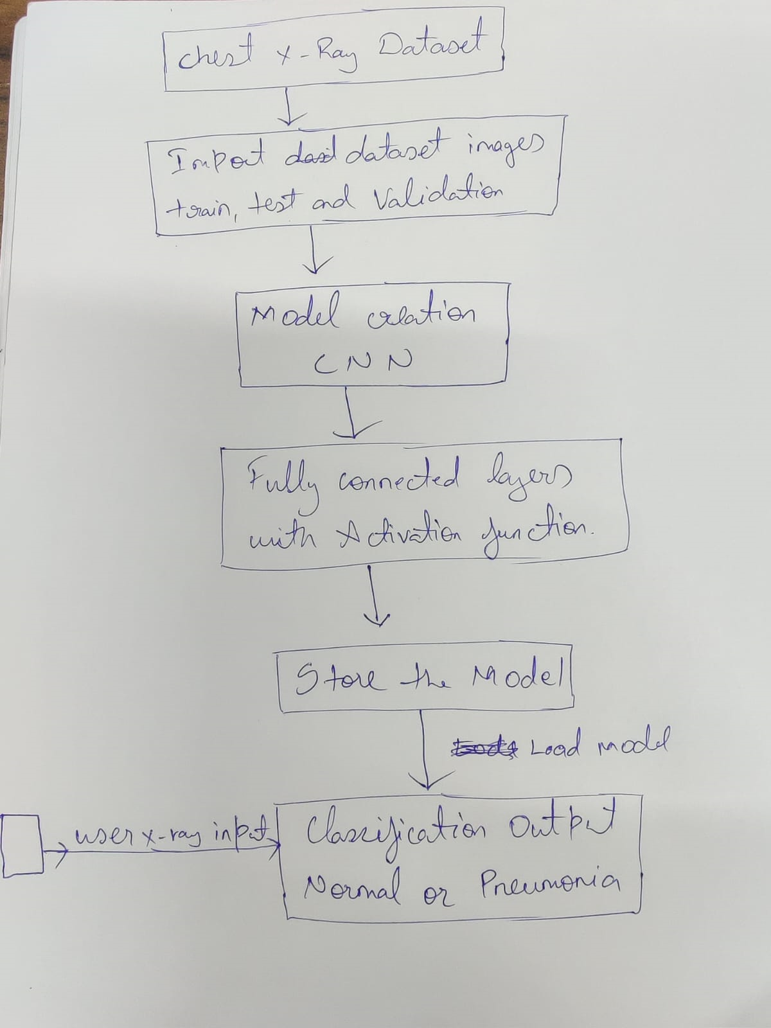
Architecture

Slide 10
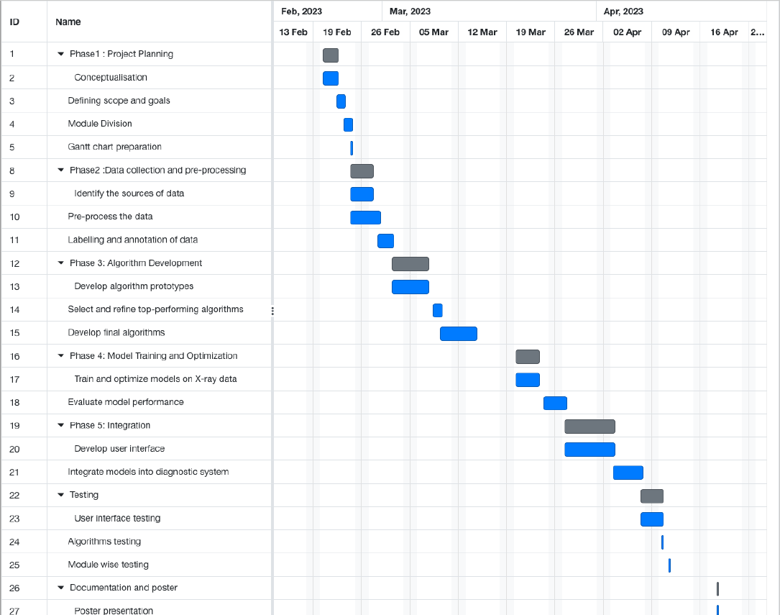
Gantt chart

Slide 11
INDIVIDUAL CONTRIBUTION
Lavaneeth : Research/collection on dataset and Model development
Siddhartha : Development of interface

Slide 12
References
[1] EMCNet: Automated COVID-19 diagnosis from X-ray images using convolutional neural network and ensemble of machine learning classifiers (2020).
[2] Pneumonia Diagnosis Using Chest X-ray Images and Machine Learning (2020).

